Slide 1
Veoneer Supplier Manual (VSM)
Site Navigation
3-APR-2020

Slide 2
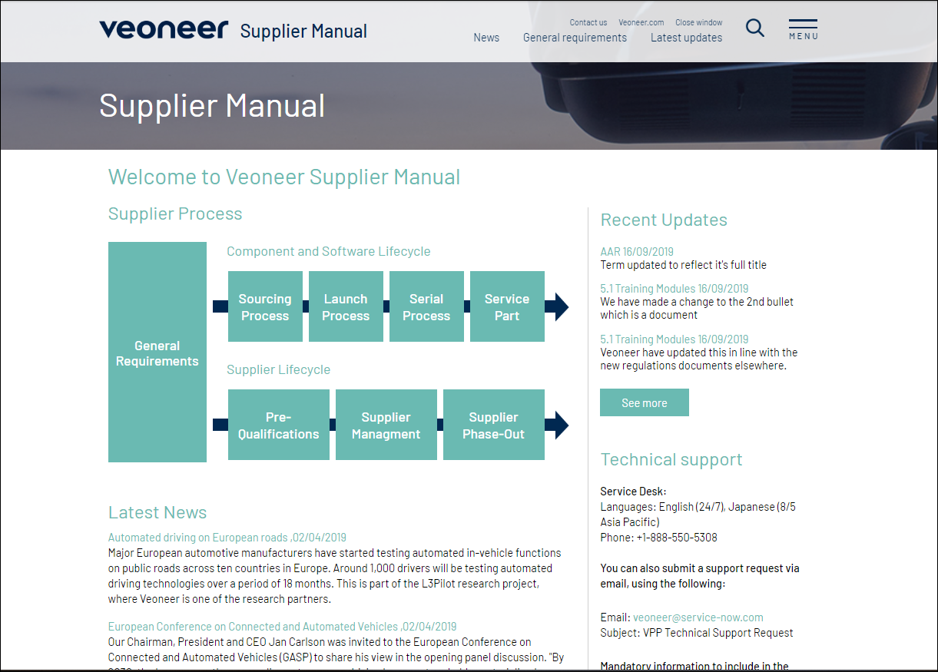
VSM Home Page from VPP
Click on MENU to navigate through all the content on this site.
OR
Click on the Supplier Process Blocks to navigate to General Requirements, Component/ SW Lifecycle or Supplier Lifecycle.
Any new updates to the VSM Sections will be posted here

Slide 3
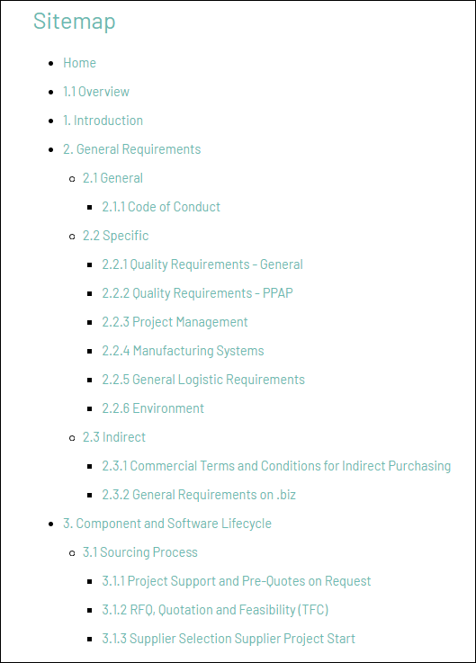
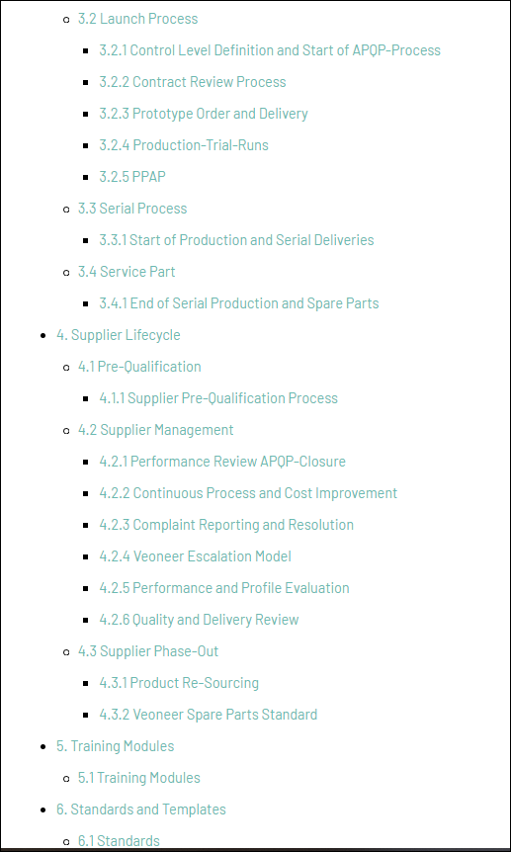
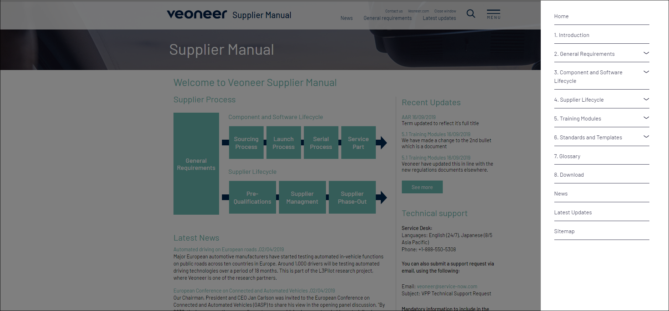
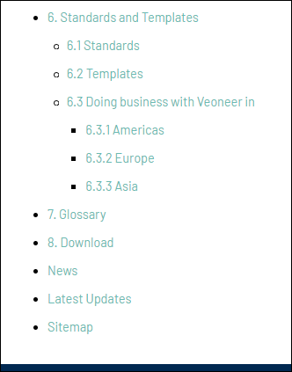
MENU
From the Menu screen, you can navigate to specific sections or use the Site Map to see all the sections and sub-sections.

Slide 4
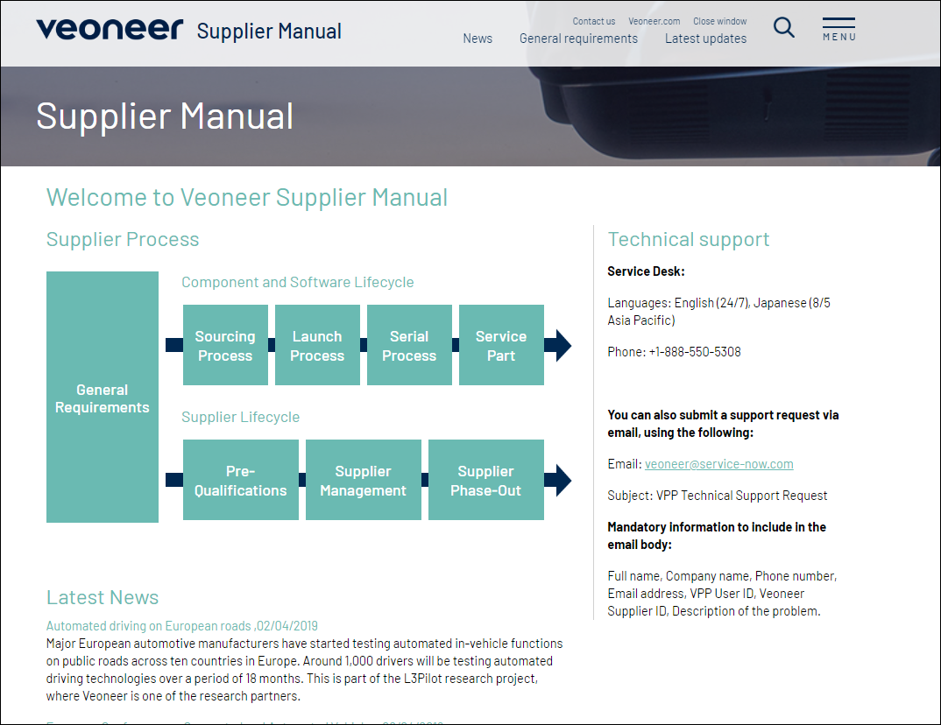
VSM Home Page from Guest/ Anonymous Login
Click on MENU to navigate through all the content on this site.
Click on the Supplier Process Blocks to navigate to General Requirements.
Please Note - Remaining Blocks or MENU content is not accessible under the Anonymous Login

Slide 5
Thank You!

