Slide 1
Supplier Cost Breakdown Training
July 2013

Slide 2
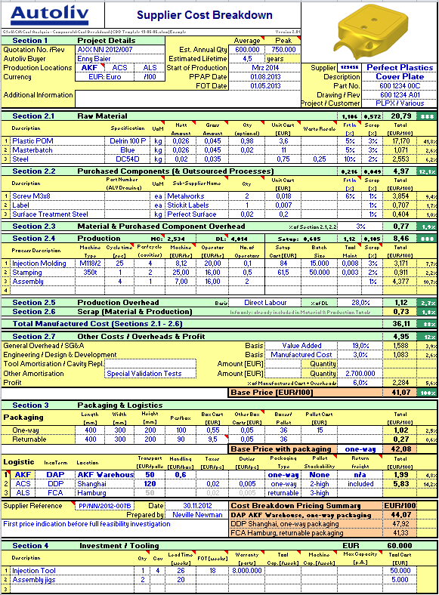

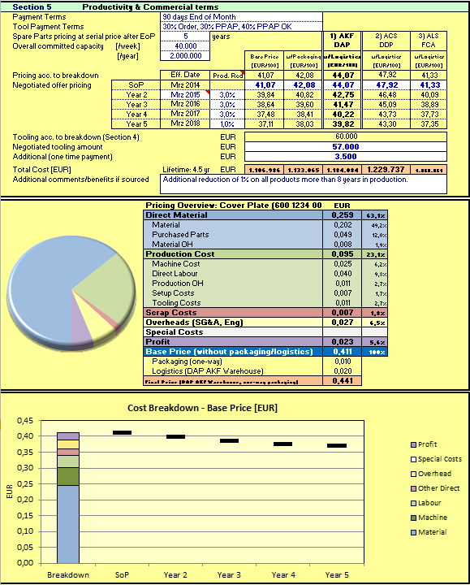
CBD - Overview

Slide 3
CBD – Main Page
General:
Always enable Content/Macros !!!
Blue areas in header are for Veoneer input only.
If the header is not blue, your Veoneer buyer has enabled editing.
White areas are user input fields
Some have drop-down menus
All calculations are done automatically
Subtotals are shown in the green header of each section
Brown areas are product totals
none indicates that user selection in a pull-down field is missing
Comment fields throughout the sheet provide short explanations.

Slide 4
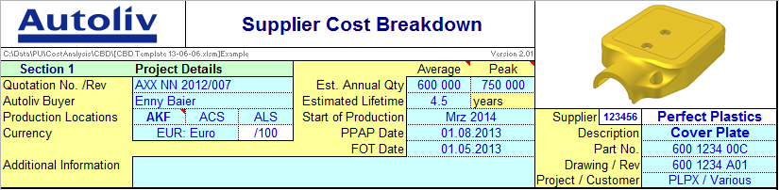

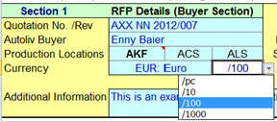
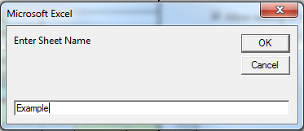
Header
Production locations to consider different packaging & logistics
Additional picture for visualisation
Costs are always entered “/piece”. Option to show the sum as /10, /100, /1000
Option to Copy Sheet and fill in CBD for different parts in same file
Sheet names should not contain spaces or special characters
Option to Clear Sheet (delete all inputs and set all drop downs to default) except Overhead Values
Option to allow editing and currency changes

Slide 5
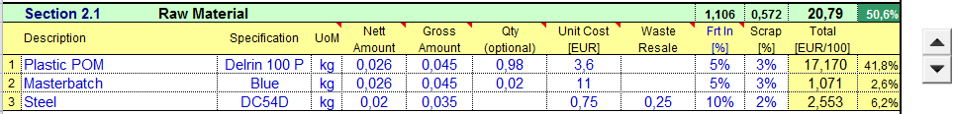
Raw Material - inputs
incl. Process waste,
do NOT include scrap
Number of parts in the final assembly.
If left empty, then 1 is assumed.
Amount/quantity of material that
ends up in the product
Unit cost
per UoM
Click arrows to add or remove lines
UoM = Unit of Measure
Net value at which waste & scrap can be resold. Enter positive values in same UoM.
Bad parts
Inbound freight – 2 methods:
[%]: Freight as % of Unit Cost
[/UoM]: Freight as value per UoM (eg kg)

Slide 6
Raw Material - calculation
Calculation of Raw Material Cost:
Qty x Unit Cost x (Gross Amount + Freight) + Scrap – Waste & Scrap Recovery
Waste & Scrap Recovery:
(Gross Amount – Net Amount + Scrap Amount ) x Waste Resale Value

Slide 7
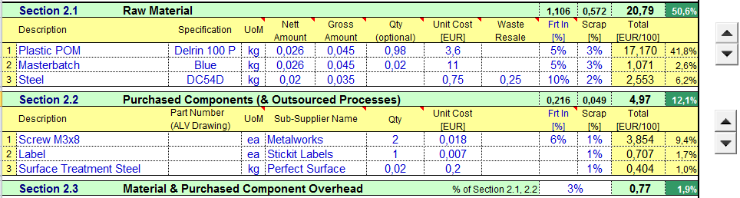
Purchased Parts & Material Overhead
MOH covers
Purchasing Department
Material Administration
Incoming Goods Control
Material Testing
Capital Investment
Warehousing
Material Handling
Input and calculation for Purchased Components (& Outsourced Processes) similar to Raw Material
Material Overhead as percentage of Material (& Purchased Components)

Slide 8
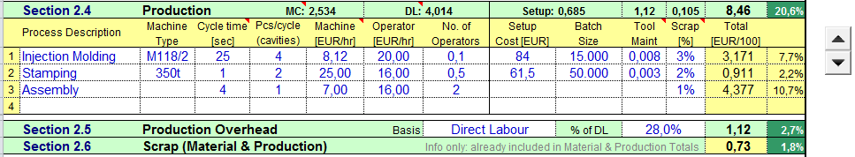
Production Processes - inputs
Cost for maintenance of the tooling, excluding initial investment (cost per part)
Nominal cycle time excl. efficiencies.
Set Up Costs per batch
Process Name and machine type to describe the operation
Machine hourly rate incl. O.E.E.
Scrap Costs for material, purchased components & Production

Slide 9
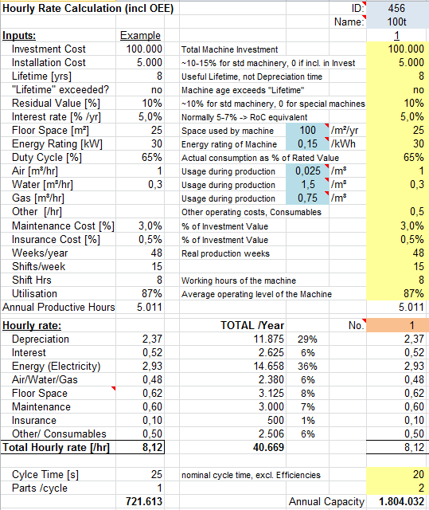
Production Processes – Machine Hourly Rate (MHR)
What does this Machine rate include?
The file contains a sheet to calculate MHR (this is optional)
Input fields are yellow,
Blue for standard parameters
White fields are calculated
Unit cost of Utilities
TOTAL /Year:
Sum of cost per category per year. Considers number of all machines listed within this sheet

Slide 10

Production Processes - calculation
Direct Labour :
Cycle time / Cavities x Operator Rate x No. Operators
Scrap Production:
% of (Machine Cost + Direct Labour)
Machine Cost :
Cycle time / Cavities x Machine Rate
Setup :
Setup Cost / Batch Quantity
Scrap :
Scrap Production + Scrap Material

Slide 11

Production Overhead
Production Overhead – Pull-down menu with 2 options
Basis Direct Labour: % of Direct Labour
Basis Value Added: % of Direct Labour + Machine Cost + Setup Cost
Flexibility to allow suppliers to choose the best method
POH covers
Intermediate Storage
Production Planning
Process Engineering
Indirect Labour Cost
Quality Department
Production Management
Disposal/Cleaning etc.

Slide 12
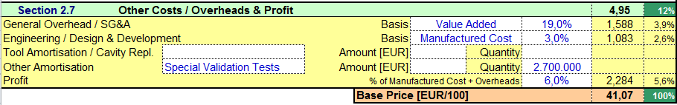

Sales General & Admin Overhead
General Overhead – Pull-down menu with 2 options
Basis Value Added: % of Machine Cost + Direct Labour + Setup Cost + Production Overhead
Basis Manufactured Cost: % of Total Manufactured Cost (Sum of 2.1 – 2.6)
Flexibility to allow suppliers to choose the most suitable method
SG&A covers
General Management
Central Planning/ Plant Management
Human Resources/ Finance/Accounting
Legal Department
General Administration
Marketing/Advertising
Market research/Analysis
Sales Organisation/ Field reps

Slide 13
Other Costs & Profit
Engineering / Design & Development
Normally to cover product development costs (if applicable), not process development
Same calculation method as for General Overhead above
Tool Amortisation / Cavity replacement / Other Amortisation
Calculation method: Investment Amount / Quantity
Profit
% of Manufactured Cost + Overheads

Slide 14
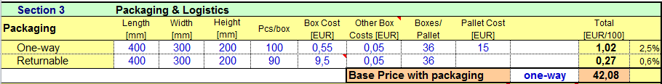

Packaging
Packaging
2 types of packaging can be shown (one-way & returnable)
Boxes/pallet is estimation, based on 1200x800 pallet, 840 height (excl. pallet)
Can be overwritten – formula is restored if <Del>-key pressed
Specific the packaging type for the Base Price: one-way or returnable.
If <Del> key is pressed none will re-appear
Sheet contains additional info calculation to consider e.g. weight limit

Slide 15
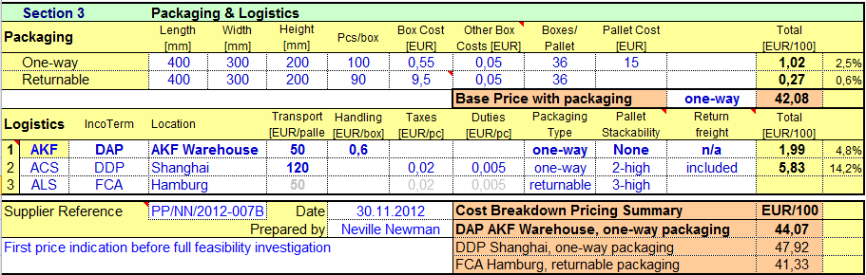
Logistics
Numbers are grey and excluded from calculation as FCA doesn`t consider logistic cost
Logistics
Line 1 is “baseline” calculation
Plants are copied from header input
Select packaging type for each logistics alternative
“Pallet stackability” & “Return freight” for clarification only - not used in calculations

Slide 16
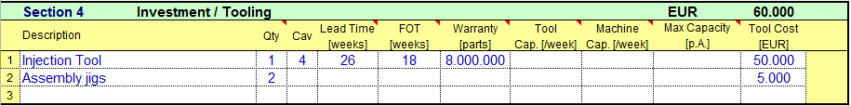
Investments & Tooling (Customer paid)
Min quantity of parts the tool can produce before overhaul. Should be independent of demand figures
Cost of 1 tool. Total calculated with Qty. field
Tool lead time, incl. PPAP documentation
Lead time to first “useable” parts – not 100% dimensional OK
Number of tools
Tool Capacity independent of demand
If the Machine is the constraint
What could the supplier deliver, if demand should increase later on.

Slide 17
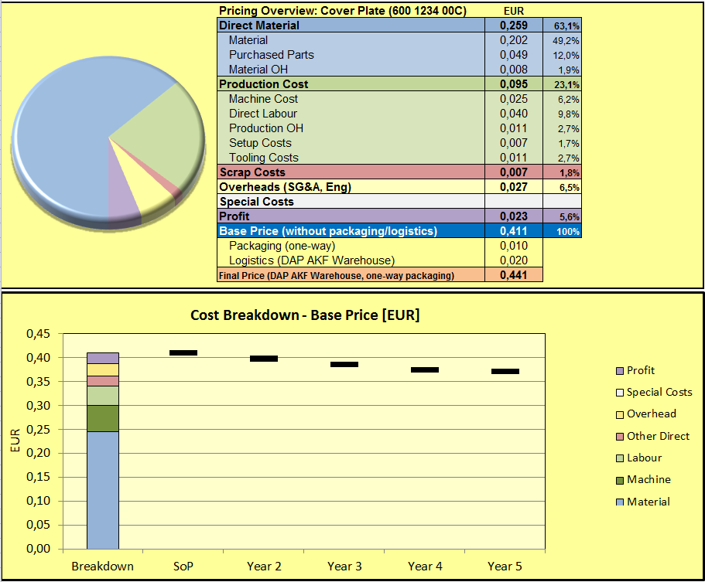
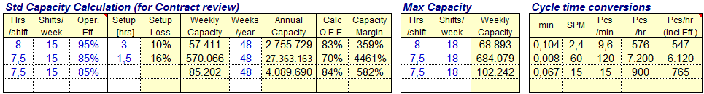
Additional Information
Pricing Overview
Summary according Cost Split from Cost Analysis Team
CBD – Visualisation
Side Tables
Performance Factor of O.E.E.
Changes to colour red if only 10% reserve left.

Slide 18
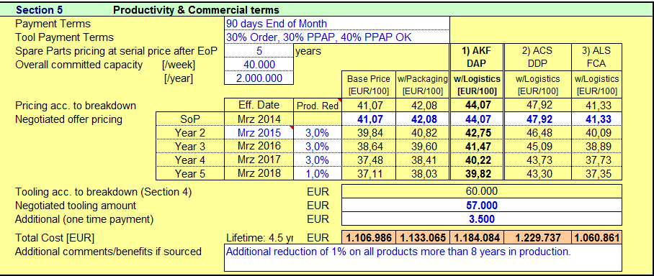
Productivity & Commercial terms
White fields need to be filled in
Summary of pricing:
Base price
+ With packaging
+ With logistic for each plant
+ Considering productivity reduction on Sales Price
Lifetime cost

Slide 19
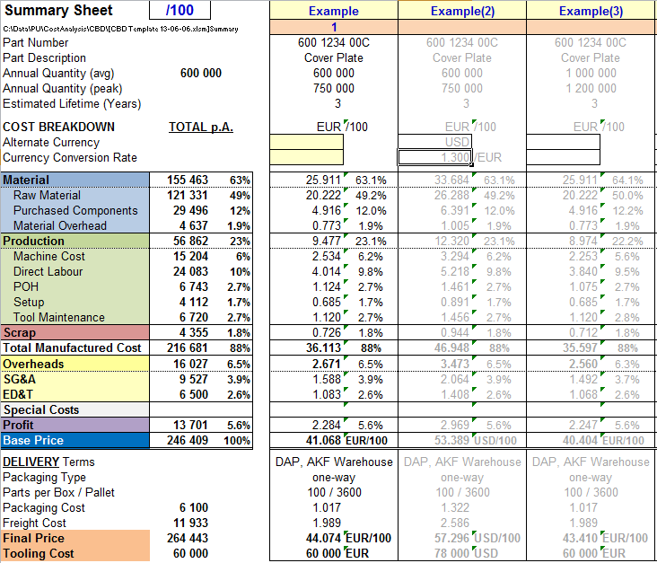
Summary Sheet
Summary Sheet to compare quotes for different parts or scenarios
Enter name according to CBD sheet name
Option to change view of totals /pc, /10, /100, /1000
Option to convert totals to an alternative currency (input alternative currency and conversion rate)
Total p.A. shows sum of categories per yearly volume for all products that are selected in Row 2 (brown).

Slide 20
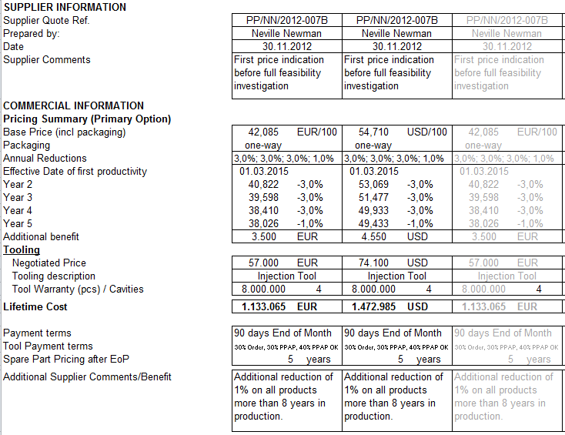
Summary Sheet - Additional Information
Summary of general Information about the part, supplier and quote

Slide 21
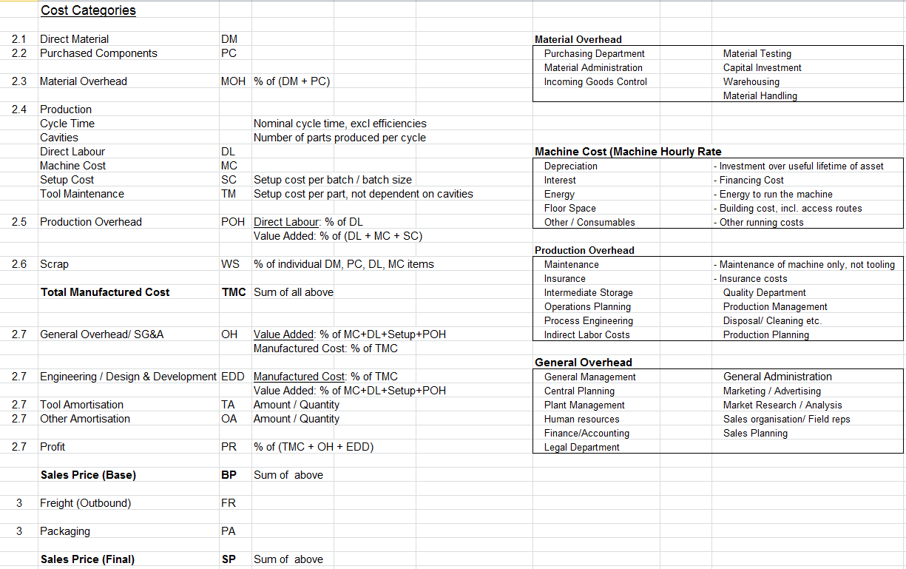
Explanations

