Slide 1

VES Assessment Training
VESS 001 Appendix C
Thomas Moberg & Markus Billock
2020-03-25
VESS-001 Appendix C VES Assessment Training

Slide 2

Veoneer Excellence System (VES)
Company
Employees
Profitability
Competitiveness
Satisfaction
Customers
Society
Just in Time
Employee Involvement
Quality First
Leveling & Capacity
Safety & Ergonomics
Quality Assurance
Continuous Flow
Flexibility & Motivation
Pull Flow
Discipline to standards
Quality Methods
Takt Time
Continuous improvements
Frequent Deliveries
Process vs Result
Six Sigma
Line Concepts
Don't Judge!
Don’t Blame!
Team Work
5S
Standards
Muda
Elimination
TPM
VESS-001 Appendix C VES Assessment Training

Slide 3

Expectations
After this training you will have learned:
Why we use a VES Assessment
The structure of the VES Assessment Excel file
How the Calculation tab is used
Contents of the VES-Element tabs
Guidelines for the assessment
Assessment Dashboard
Assessment frequency
Participants and responsibilities
VESS-001 Appendix C VES Assessment Training

Slide 4
Why we use a VES Assessment
To provide a clear vision of what is required to achieve operational excellence.
To evaluate the VES Maturity at each plant and challenge current conditions.
To assess leadership behaviors in correlation with evidence in the workplace in order to clarify the desired culture.
To help plants define actions for improvement and provide a tool for follow-up of progress.
To learn from each other and benchmark best practices between plants.
To run the assessment as a discovery exercise instead of an “Audit”.
VES Assessment is not a competition between plants!
VES Assessment is a honest reflection of the plant status and do not hide problems!
VES Assessment will help each plant to grow by questioning and learning!
VESS-001 Appendix C VES Assessment Training

Slide 5
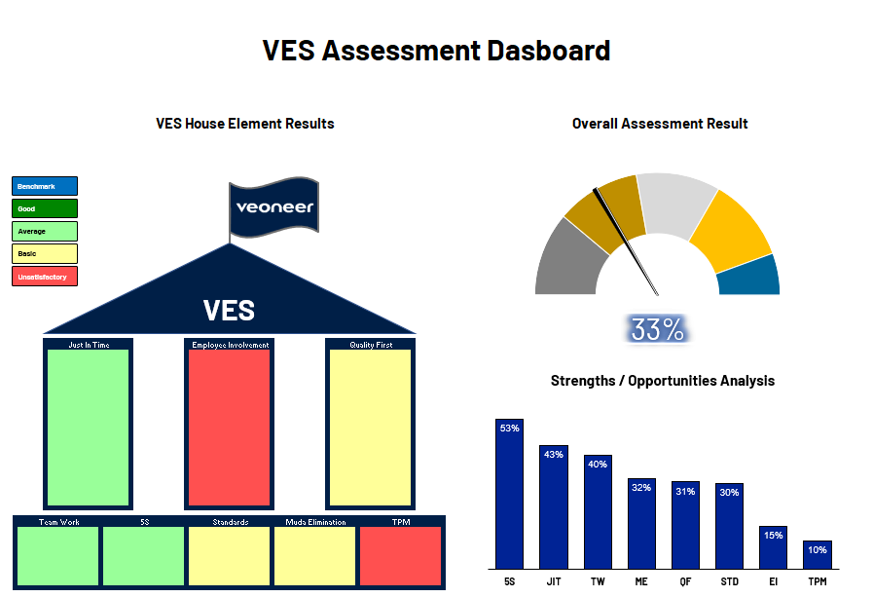
Structure of the VES Assessment Excel file
Dashboard
Calculation of results
QOS chart
An assessment sheet for each VES-element
Summary of observations
Instructions & Definitions
VESS-001 Appendix C VES Assessment Training

Slide 6
Calculation tab
A calculation tab is provided to standardize the sample size and formulas for objective statements within each VES Element and component.
The calculation tab should be completed before the Assessment begins
VESS-001 Appendix C VES Assessment Training

Slide 7
Contents of the VES-Element tabs
Element Name
Mission Statement
Components
Assessment in 3 main areas
Leadership Behaviors
Workplace Evidence
Width
VESS-001 Appendix C VES Assessment Training

Slide 8
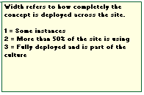
Contents of the VES-Element tabs
Leadership statements are focused on what types of behaviors we see from the site management team.
Statements added for all elements and components for levels 1-5.
Workplace statements are focused on what kind of verifiable evidence we should see at the Genba.
Statements added for all elements and components for levels 1-5.
Width column focuses on how completely a concept is deployed in the site.
VESS-001 Appendix C VES Assessment Training

Slide 9
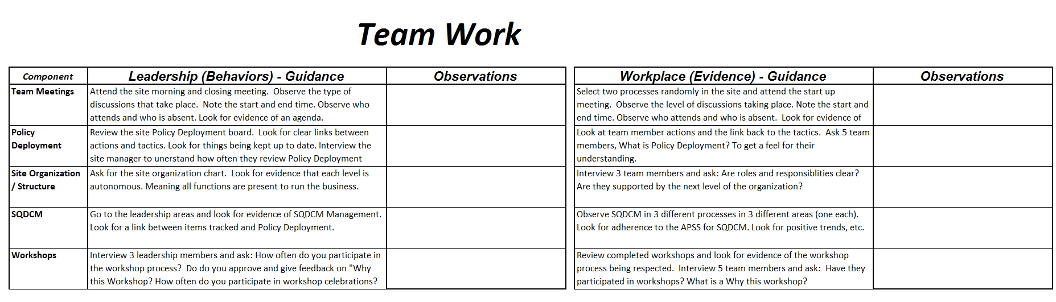
Guidelines for the assessment
A guideline is available as appendix to the standard, for each element and component, to give the users ideas on where to look for evidence and behaviors. (Use is not mandatory)
VESS-001 Appendix C VES Assessment Training

Slide 10
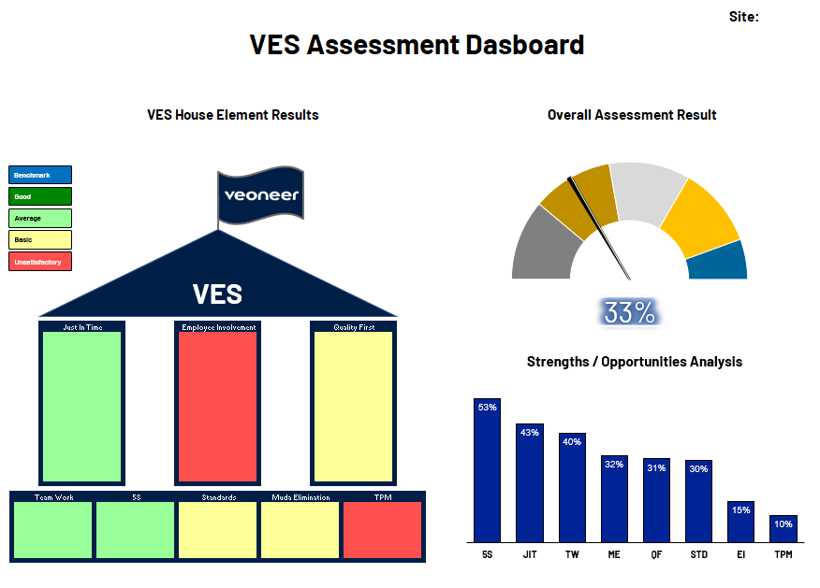
Assessment Dashboard
Visual Management shown by colors of the VES House.
Benchmark (>80%)
Good (>=60%)
Average (>=40%)
Basic (>=30%)
Unsatisfactory (<30%)
Overall Assessment Indicator
Platinum > 89%
Gold = 68-89%
Silver = 45-67%
Bronze = 22-44%
Basic <22%
Strengths / Opportunities Pareto
VESS-001 Appendix C VES Assessment Training

Slide 11

Assessment frequency
Each site will complete a quarterly self assessment
External calibration will occur as follows:
Each plant, every other year.
Or if the site self-assessment reaches Gold or Platinum level, the site will call for a calibration to validate their result.
Calibration = Experienced VES persons doing a neutral evaluation with the site management team
VESS-001 Appendix C VES Assessment Training

Slide 12
Participants and responsibilities
It is the responsibility of the site manager to ensure the proper resources are assigned to complete the VES Assessment. Additionally, the site manager is responsible to ensure actions are documented and proper follow up is applied to move the site forward.
It is the responsibility of the site VES manager to plan and execute the assessment at the right frequency and to include the right participants.
Quantity = 3-5 participants (for each VES-element)
Include all levels & Functions (Cross Functional)
Site Manager
Manager / supervisor
VES
Line leader / operator
Functional Support areas
All actions that come as a result of the VES Assessment need to be linked to helping the site to achieve their main KPI’s. Additionally, the actions must be prioritized to align with the site Policy Deployment. Although a tab exists for the purpose of documenting the main take a ways from each element, the actions will be tracked in the sites normal action plan (LOP).
VESS-001 Appendix C VES Assessment Training

Slide 13
Expectations
Please answer to the following questions:
Why do we use a VES Assessment?
What is the structure of the VES Assessment Excel file?
How is The Calculation tab used?
What are the contents of the VES-Element tabs?
Where do you find guidelines for the assessment?
What can you see on the Assessment Dashboard?
What are the assessment frequencies?
Who should participate to the assessment?
VESS-001 Appendix C VES Assessment Training

Slide 14
Thank you for your attention!
VESS-001 Appendix C VES Assessment Training

