Slide 1
VS007 Appendix J - Supplier Training on Supplier initiated Change Request (SCR) End Of Life announcement (EOL)
SQPS-939
Stéphane Dumont
Senior Manager, Supplier Quality

Slide 2
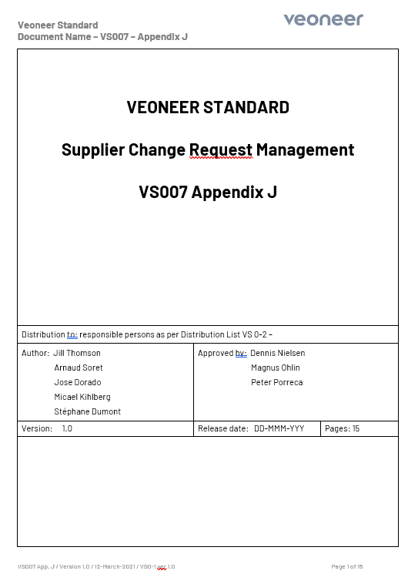

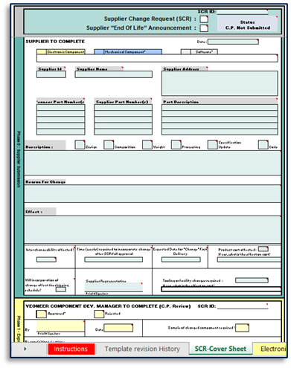
VS007 Appendix J : Supplier Change Request Management
VS007-J
VS007 is the Veoneer Standard for internal change management.
Appendix J of VS007 describes the process for Supplier initiated Change Request (SCR). In particular, it outlines the interactions between the Supplier and the Veoneer Change Process team (VS007 CCB Process).
The supplier is responsible for initiating the Change Request by using the SCR (Supplier Change Request) Template.
End Of Life announcement (EOL) is a notification by the supplier that a product will be discontinued. It is considered a particular type of change, however the same process applies and the templates to use are the same.
Together with the SCR, the supplier is responsible for submitting a set of documents hereinafter identified as “Change Package” (C.P.) using the applicable tab in the SCR Excel file.
Latest revision of VS007 Appendix J and SCR Template documents can be accessed by the supplier in the Veoneer Supplier Manual (VSM).
SCR Template

Slide 3
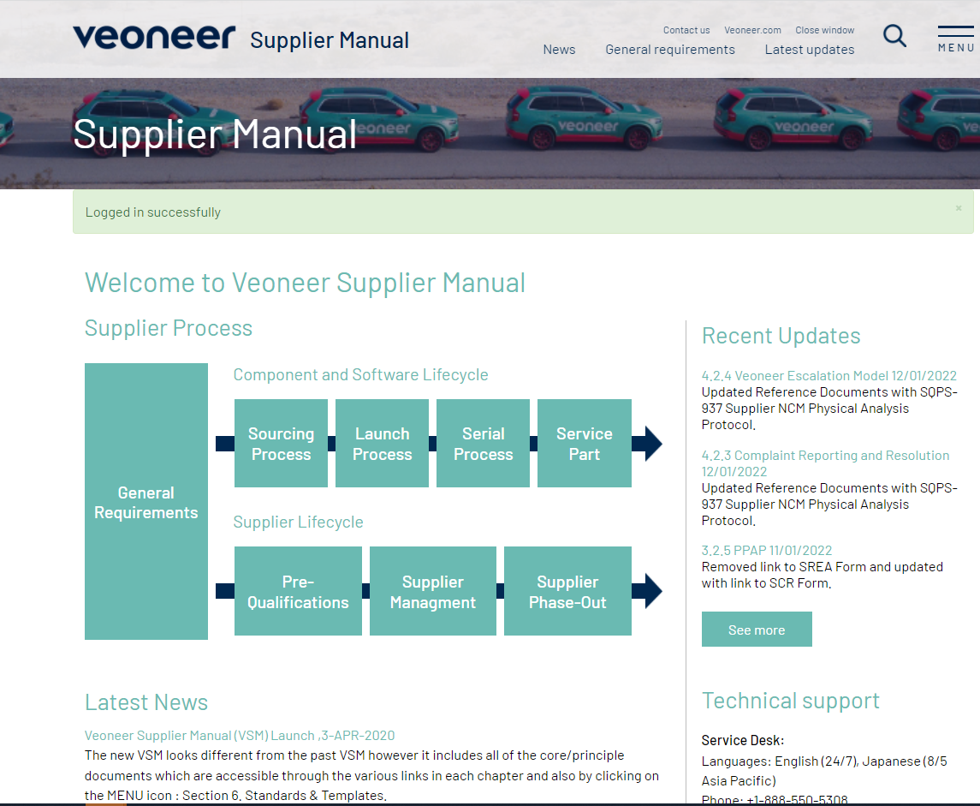
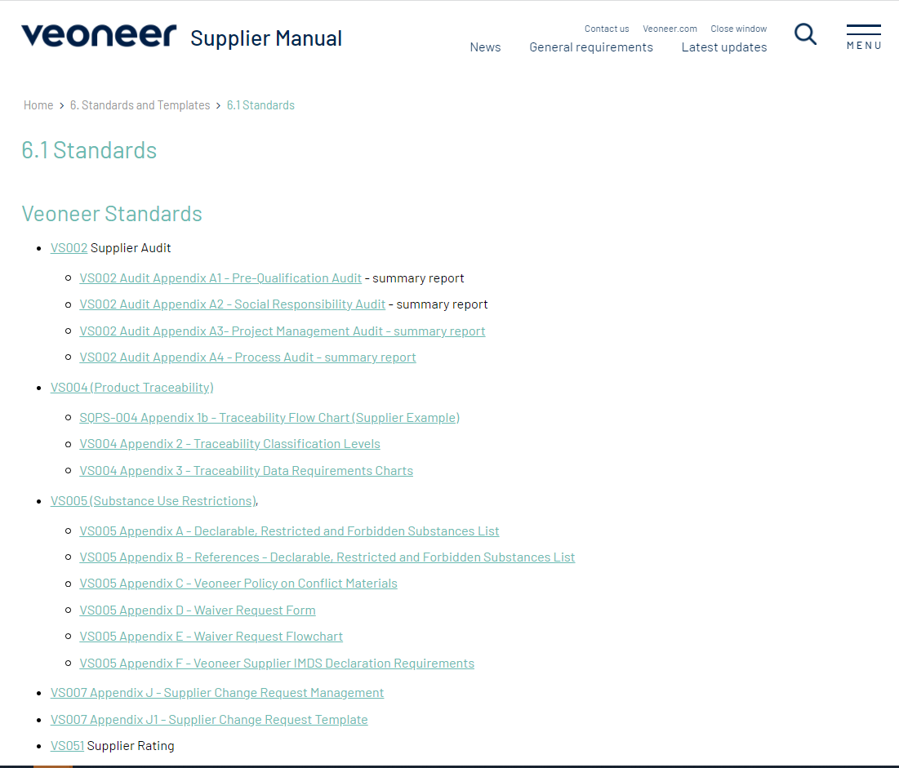
VS007 Appendix J : Supplier Change Request Management
How to access VS007 Appendix J and the SCR (Supplier Change Template) template :
1 - “Open Standards and Templates”
2- Click on “Standards”
From VSM Page, Click “MENU”

Slide 4
VS007 Appendix J : Supplier Change Request Management
Process Flow :
The procedure is broken down in 6 phases numbered from 0 to 5 (See Figure 1 : SCR Phases):
Supplier Submission
Phase 0
Exploratory Viability
Phase 1
Serial Preparation
Phase 2
Validation Plan
Phase 3
PPAP Approval
Phase 4
Release for Serial Production
Phase 5
C.P.
Complete
C.P.
Approved
CCB1
Complete
CCB2
Complete
SCR_P5
SCR Full
Approval
The detailed Process Flow describing the Supplier Initiated Change Request process can be found on next slide.
Phase 0 is where the supplier submits the SCR and all required documentation. All the other steps are handled by different Veoneer groups (Veoneer Lead Buyer, Component Organization, Supplier Quality, Change Leader …. )
C.P. = Change Package
CCB = Change Control Board

Slide 5
Supplier Change Process - Overview
Supplier Submission
Phase 0
Exploratory Viability
Phase 1
Serial Preparation
Phase 2
Validation Plan
Phase 3
PPAP Approval
Phase 4
Release for Serial Production
Phase 5
Supplier
Information
C.P.
Complete
C.P.
Approved
CCB1
Complete
CCB2
Complete
SCR_P5
SCR Full
Approval
Change
Documentation
Submission
Waiting for feedback on change documentation
Waiting for Veoneer’s CCB approval to proceed further
PPAP Documentation Submission
Waiting for SCR Full Approval before shipment
SCR File
CP Rejected by Component Group
CP Approval by Component Group
SQP
Creation
by SQ
SCR_P5_
Interim PPAP
Approval PSW
PPAP
Change
Documentation
Review
Veoneer’s Internal CCB activities
SQP/PP Documentation Review
Veoneer Product Validation & CCB
Veoneer
Jan 21, 2022

Slide 6
Supplier Change Process – Detailed Flow
VS007 CCB Process
Change initiation
Change Evaluation
Change Validation
Closure
CCB1 Prep.
CCB1
Validation Plan
CCB2
P.V. & Line trial
CCB3
CCB4
ECR
Change Package Submission
C.P. Approval by Component Org
Any Action as requested by CCB1
PPAP Submission
PN Change ?
No
SCR_P5_ Interim PPAP
( for samples)
PSW Approval
Interaction between Supplier and VS007 CCB Process
Yes
PSW Approval
C.P. Need update
Supplier Submission
Phase 0
Exploratory Viability
Phase 1
Serial Preparation
Phase 2
Validation Plan
Phase 3
PPAP Approval
Phase 4
Release for Serial Production
Phase 5
Supplier
Information
C.P.
Complete
C.P.
Approved
CCB1
Complete
CCB2
Complete
SCR_P5
SCR Full
Approval
Jan 21, 2022

Slide 7
End Of Life Announcement – Detailed Flow
VS007 CCB Process
Change initiation
Change Evaluation
Change Validation
Closure
CCB1 Prep.
CCB1
Validation Plan*
CCB2
CCB3
CCB4
ECR
* (Validation plan = Exit Criteria to achieve End of Life)
Change Package Submission
C.P. Approval by Component Org
Any Actions requested by CCB1
EOL
Order
Interaction between Supplier and VS007 CCB Process
C.P. Need update
Supplier Submission
Phase 0
Exploratory Viability
Phase 1
Serial Preparation
Phase 2
Validation Plan
Phase 3
PPAP Approval
Phase 4
Release for Serial Production
Phase 5
Supplier
Information
C.P.
Complete
C.P.
Approved
CCB1
Complete
CCB2
Complete
SCR_P5
SCR Full
Approval
Jan 21, 2022

Slide 8
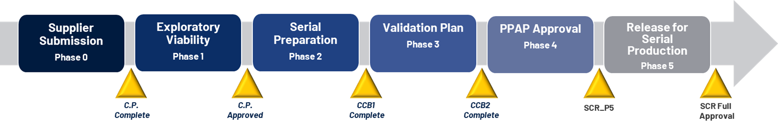
Phase 0 : Supplier Submission

Slide 9
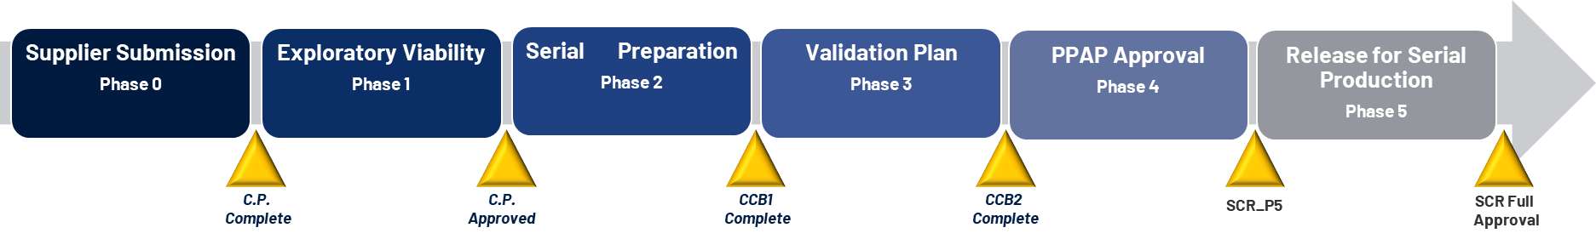
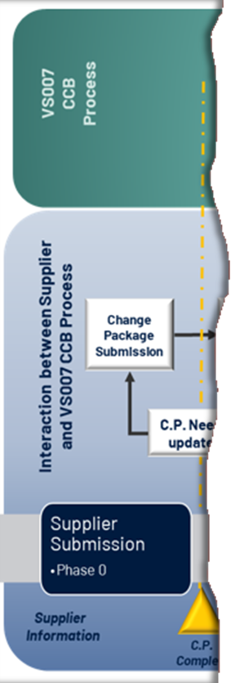
Supplier Change Request Management
Phase 0 : Supplier Submission
The supplier is responsible for initiating the process by submitting a Supplier Change Request (SCR)
“Change” is a key event in the life of a purchased Product, and it necessarily implies a modification of the previous agreements related to this component:
The approved PPAP becomes obsolete,
The Specification might be affected
The logistic flow might be impacted,
The production sequence might be modified,
Some production test might be removed or changed,
....
All these topics are essential elements in the price of the currently purchased component. Consequently, the SCR must be submitted to the Veoneer Lead-Buyer, thus he can keep the control of the costs/price.
Note : The exact same process applies to “End Of Life” Announcement.

Slide 10
Supplier Change Request Management
Phase 0 : Supplier Submission
The “C.P. Complete” milestone associated with the closure of Phase 0 is to be signed off by the Supplier. With the approval of this milestone, the Supplier is confirming that the documentation provided (SCR and C.P.) is complete and no item is missing.
After the Veoneer Lead Buyer receives the Complete SCR, she(he) will share the set of documents to the Veoneer Core Team :
Component Development Manager;
Component Engineer;
Lead Buyer;
Commodity Supplier Quality Engineer.

Slide 11
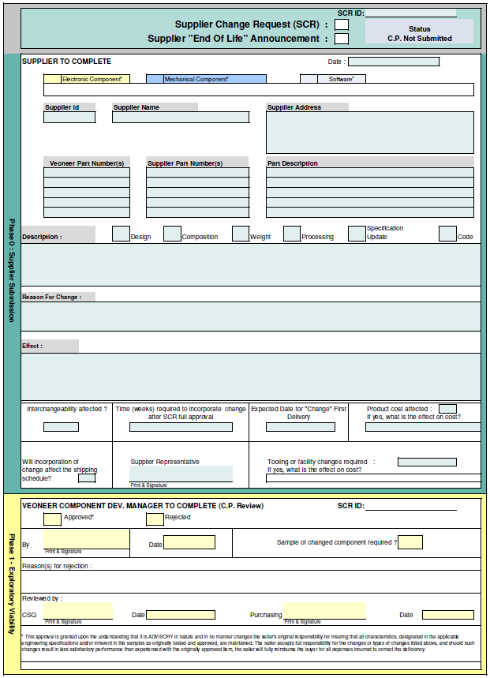
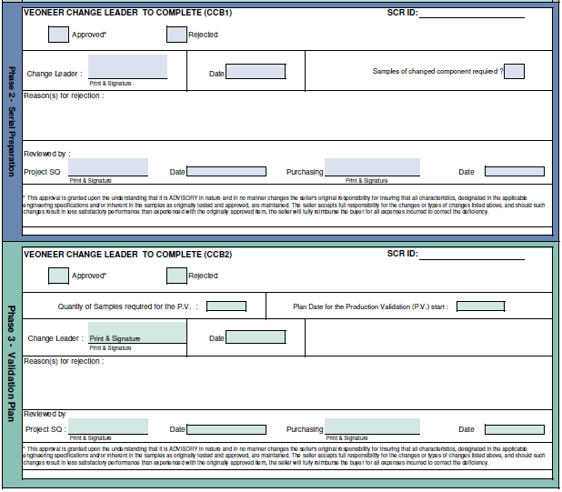
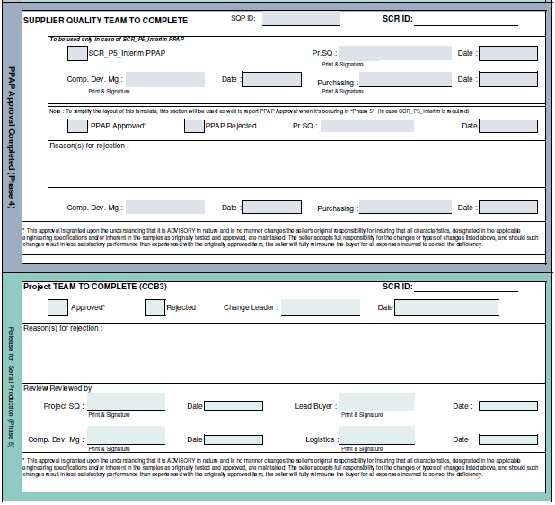
VS007 Appendix J : Supplier Change Request Management
SCR Template :
SCR Template: Document is stored in VSM and the latest revision shall be downloaded each time the supplier intends to Submit a Change Request.

Slide 12
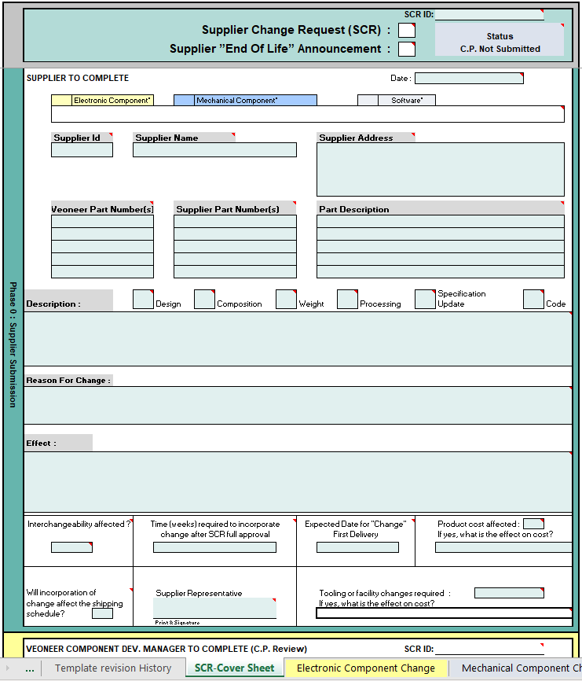
Change & EOL Submission : « To complete the « SCR Coversheet »
To initiate the change, the Supplier first completes the section “Phase 0 : Supplier Submission” of the “SCR-Cover Sheet” from the SCR excel file.

Slide 13
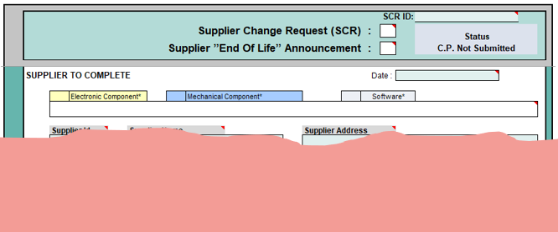
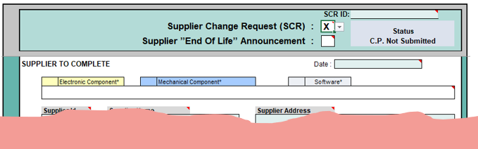
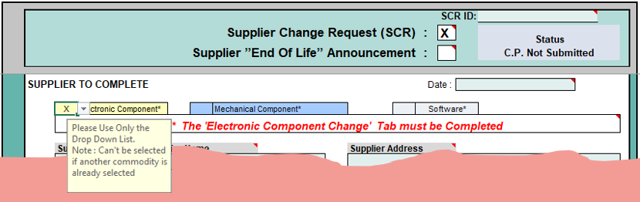
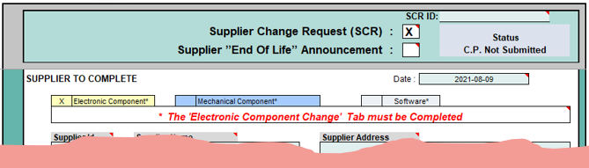
Submission : « To complete the « SCR Coversheet »
Step 1 : Type of Change and Product Category
First the supplier must identify the scope of change (“Supplier Change Request” or “Supplier End Of Life Announcement”)
Note : This step makes it possible to distinguish between a Change Request and the “End Of Life” Announcement (EOL).
The Product Category to which the modified part number(s) belong to must be identified by “Checking” the corresponding box.
The Date when the SCR is submitted or is updated by the supplier must be recorded.
A
B
C
When the commodity type is « checked » the file provides a reminder about what other spreadsheet has to to be completed.
When the commodity type is « checked » the file provides a reminder about which other spreadsheet must be completed.

Slide 14
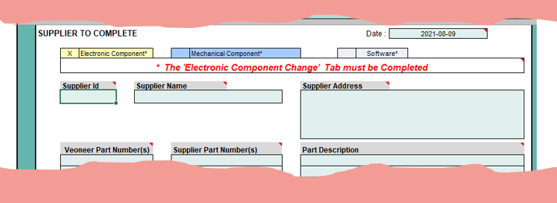
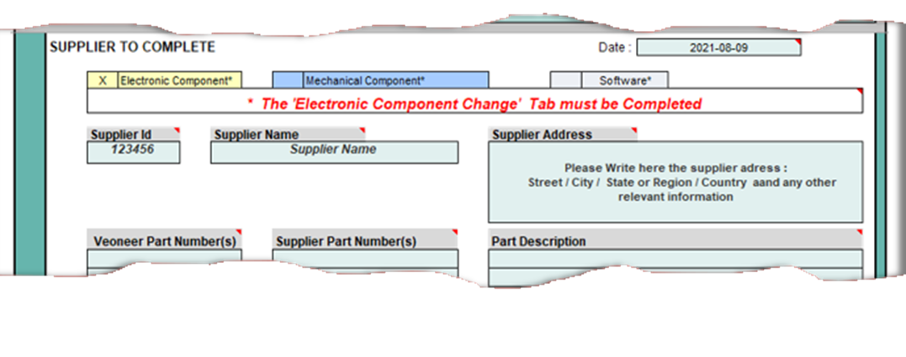
Submission : « To complete the « SCR Coversheet »
Step 2 : Supplier Information
The supplier is asked to fill in the Supplier Id. This Id must be the one reported in the PSW from the latest approved PPAP for the affected device(s).
The Supplier Name must be filled in and must the same as the one reported in the PSW from the latest approved PPAP for the affected device(s).
Similarly, the supplier must provide the Supplier Address, which must be the same as the one written on the latest approved PPAP.
D
E
F

Slide 15
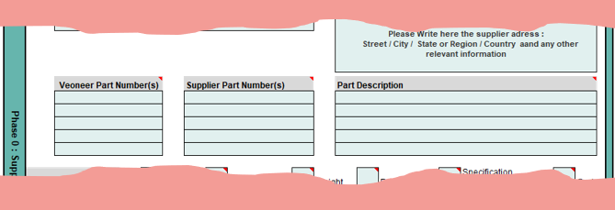
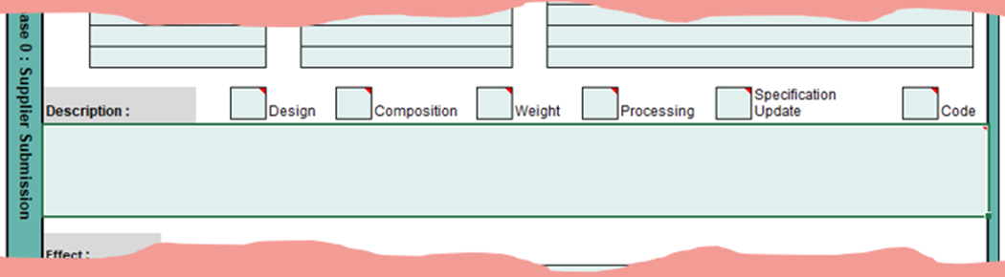
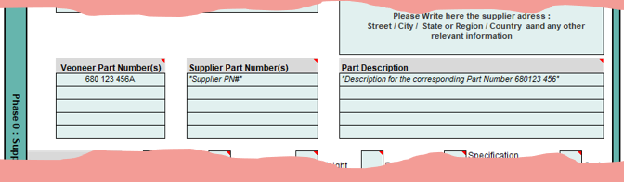
Submission : « To complete the « SCR Coversheet »
Step 3 : Affected Devices
The supplier provides the complete list of Veoneer Part Number(s) affected by the change (or by the “EOL”) and currently purchased by Veoneer or purchased in the past years by Veoneer.
Note : Additional lines may be added if necessary (Select a complete line by selecting the row number and then right-click : "Insert“).
Together with the Veoneer list of affected Veoneer Part Number(s), the Supplier provides the “Supplier Part number”. The Supplier Part Number must be the one reported in the PSW from the latest approved PPAP.
Also, associated with the Veoneer Part Number, the Part Description, the same one reported in the PSW from the latest approved PPAP, must be recorded here.
G
H
I

Slide 16
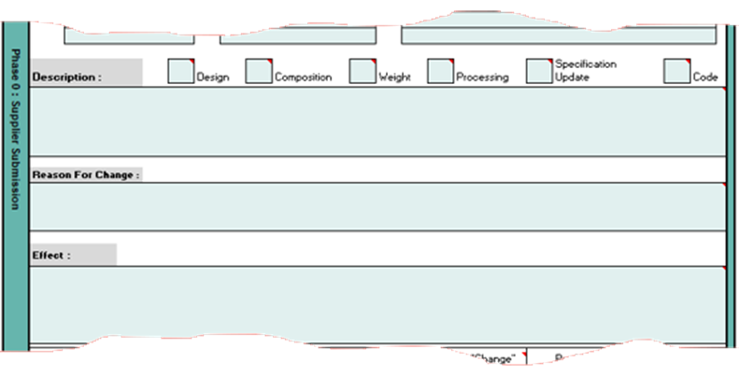
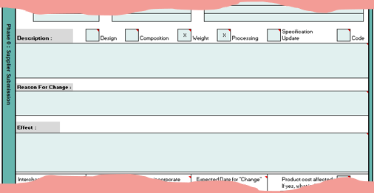
Submission : « To complete the « SCR Coversheet »
Step 4 : Change Description and Effect of the change
The supplier must check the box(es) corresponding to the different areas affected by the change. Select from the drop-down list.
For EOL the checked box will represent the affected area when introducing the substitute component, if any.
Under the “Description” header, the supplier must provide a detailed description of the change.
For EOL, a justification must be provided. Then, If ordered volume is still significant, the supplier shall offer a substitute component.
Note : The cell height can be adjusted if necessary.
Under the “Reason For Change” header, the supplier is requested to provide justification why the change is required.
For EOL, the “Reason” why the supplier intends to stop producing.
Under the “Effect” header, the supplier must indicate what are the effects of the change
For EOL, the “Effect” when using the substitute component.
This section is a summary of the risk analysis performed by the supplier.
K
L
J
M

Slide 17
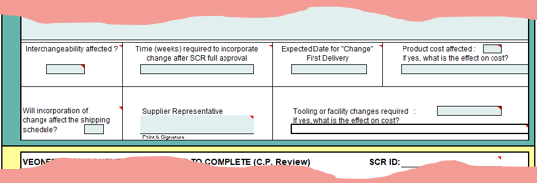
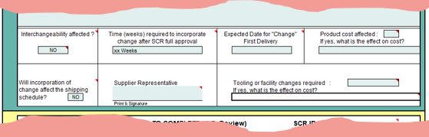
Submission : « To complete the « SCR Coversheet »
Step 5 : Additional details about the change
The Supplier must answer “Yes” or “No” if the assembly and/or component Interchangeability of the purchased product are affected (i.e.: Can we swap the unmodified product with the modified one without any further process and/or component adjustment). Select from the drop-down list.
It must be indicated here if the introduction of the change (or EOL) will impact the delivery schedule or not. Select from the drop-down list.
The supplier is requested to enter the Date when the device will be ready for shipment to Veoneer after the change is approved (i.e. : When Veoneer provides final approval, how long time is required to have "modified product" ready for shipment to Veoneer).
N
O
P
Information given here is only for example and must be adjusted as needed for the change being addressed

Slide 18
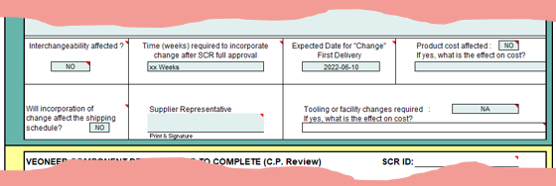
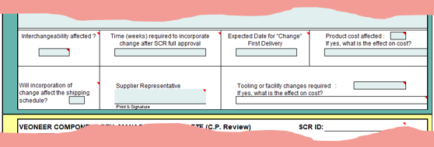
Submission : « To complete the « SCR Coversheet »
Step 5 : Additional details about the change (Con’t)
Indicate if the price of the purchased product will be affected or not by the change or by the EOL - Usage of the substitute device or EOL Order - (Select from the drop-down list). If so, record the effect in the field just below.
From the pulldown list, the Supplier must select "Tooling", "Facility“ or “Tooling and Facility” if any Tooling and/or Facility changes are required for this SCR. If so, enter the cost impact in the field below. Select "N/A" from the pulldown list in case the Tool/Facility doesn’t belong to Veoneer.
The Supplier must record the Expected Date for the first delivery for serial production of component with the Change implemented.
Finally, the SCR must be signed by the supplier before being submitted to the Veoneer Lead Buyer.
S
Q
R
T
Information given here is only for example and must be adjusted as needed for the change being addressed

Slide 19
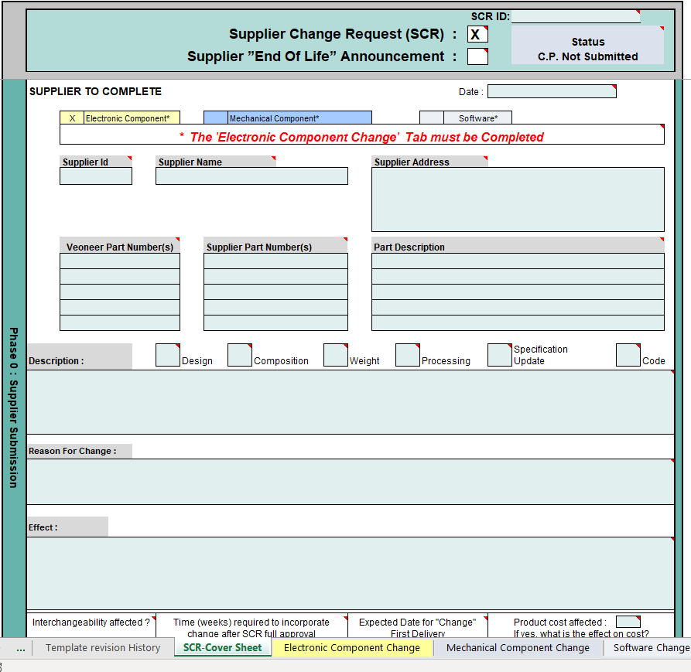

Submission : «Documentation to be provided»
Depending on the product category impacted by the change (or EOL), the supplier is requested to share documentation as described in the worksheet associated with that product category.
For a quick and efficient management of a change request, it is important that the documentation provided meets expectations from the very beginning.
Any discrepancy or missing document will result in additional activities and will add delays in the approval process.
When Signing this SCR and sending it to the Veoneer Lead Buyer, the supplier commits “that the documentation provided (SCR and C.P.) is complete and no item is missing”.

Slide 20
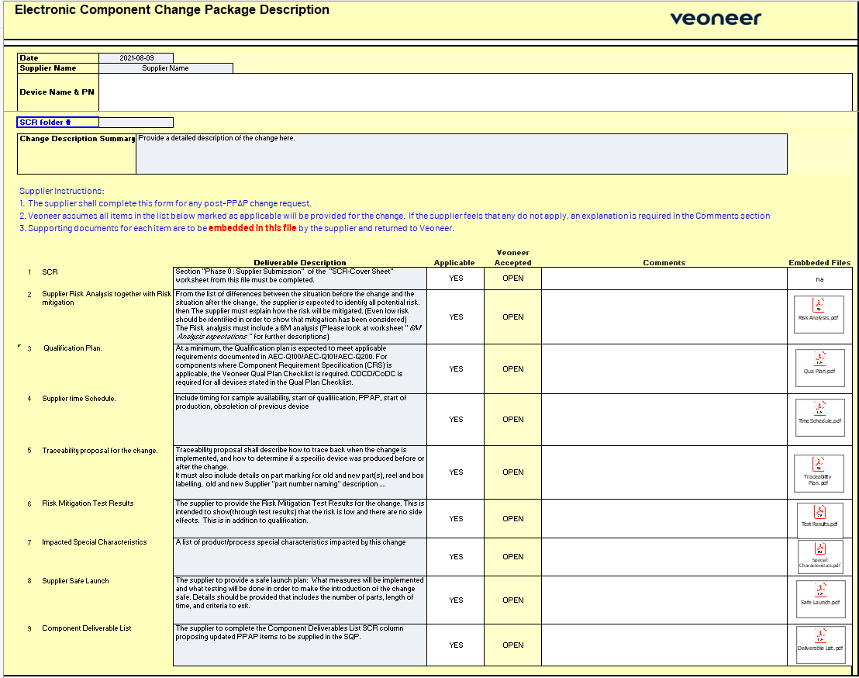
Change & EOL Documentation
The following two pages describe how to use the “Electronic Component” product category
worksheet to submit documents.
This is only an example, and the exact same process applies for any other Product Category
Blank field to be completed
By default, all deliverables and required documentation are applicable. In very specific situations for which the topic does not apply (in particular : End Of Life) it is possible to choose "NO" from the drop-down list. In this case the supplier must justify in the comments field why it is not applicable. Note that after review, Veoneer may disagree, in which case documentation will be mandatory before proceeding further with the change.
The requested documentation must be embedded in the last column of the table (See next page instructions about how to embed a file in a spreadsheet).

Slide 21
Change & EOL Documentation : How to embed a file
4 : Click « Create from file »
2 : Click on « Insert »
6 : Click « Browse»
3 : Click on « Object »
5 : Check the Box « Display as icon »
1 : Click on the cell where to insert the file
6 : Browse folders and select file
6 : Browse folders and select file
8 : Click “OK”
7 : Click “Insert”

Slide 22
Phase 1 : Exploratory Viability

Slide 23
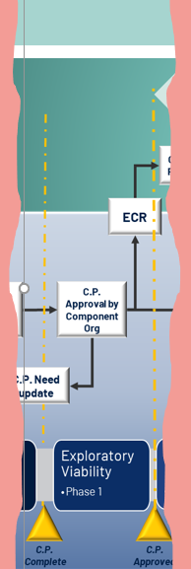
Supplier Change Request Management
Phase 1 : Exploratory Viability
The Veoneer Core Team Reviews the supplier documentation to verify it is complete and to ensure that the change (or EOL) does not present any quality, technical or financial risk for Veoneer.
Veoneer Core Team oversees Phase 1:
Component Development Manager;
Component Engineer;
Lead Buyer;
Commodity Supplier Quality Engineer.
If the provided documentation is incomplete, the “C.P. Complete” milestone will be revised, and the process flow will revert back to “Phase 0” : The supplier is requested to update the Change Documentation
In case the team determines the change carries an unsustainable risk (Quality, Technical, Supply, Financial … ) for Veoneer the change will be rejected.

Slide 24
Phase 2 & 3 : Serial Preparation & Validation Plan

Slide 25
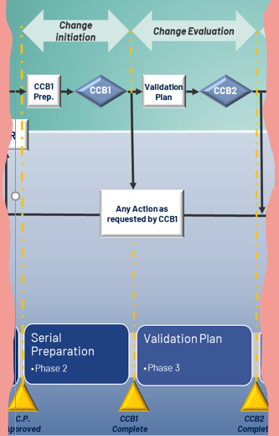
Supplier Change Request Management
Phase 2 & 3 : Serial Preparation & Change Evaluation
After Milestone “C.P. Approved” is granted, the Veoneer internal Change Process is initiated. It is conducted exclusively within the framework of the overall Veoneer CCB VS007 process.
The Veoneer “Change Leader” is leading the team activities all along these steps until the “CCB1 Complete” and “CCB2 Complete” milestone are granted.
If for any reason CCB1 or CCB2 is rejected, the Supplier Change Request will be rejected.

Slide 26
Phase 4 : PPAP Approval

Slide 27
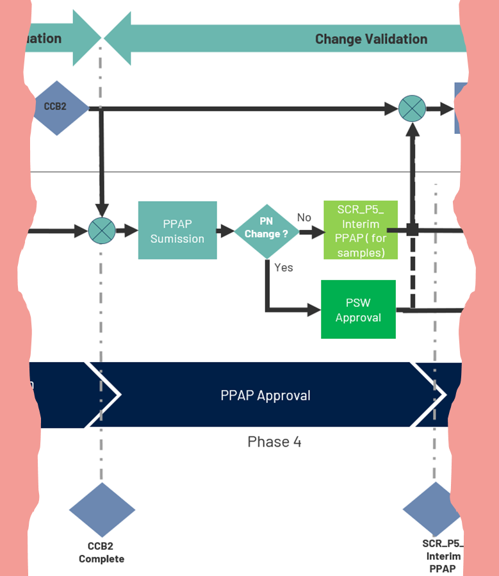
Supplier Change Request Management
Phase 4 : PPAP Approval or SCR_P5_Interim Approval
Once Milestone “CCB2 Complete” has been approved by the Veoneer CCB, which allocates resources to work on the change validation/qualification, the SQP (Supplier Quality Project) and PPAP activities can be initiated.
For “End Of Life”, this specific step corresponds to the “End Of Life” Order.
The Veoneer Project SQ (Identified by the Commodity SQE) oversees this phase together with the Supplier’s Quality counterpart.
Changes without “Part Number change”:
Instead of PPAP approval, “SCR_P5_Interim PPAP” will be issued (Modified product mustn’t be used for serial production before Veoneer’s P.V. status is ”PASS”).
The “SCR_P5_Interim PPAP” is a specific Interim PPAP approval dedicated to SCR without Part number change, and it will be limited to the Quantity of device required for the manufacturing of Product Validation builds (The CCB decides the quantity needed and the Project SQ communicates it to the supplier).
For Changes with “Part Number change”:
The Veoneer Project SQ will proceed with a standard PPAP approval, similar to the SQP/PPAP process applied for new developments.

Slide 28
Supplier Change Request Management
Phase 4 : PPAP Approval or SCR_P5_Interim Approval (Con’t)
IMPORTANT INFORMATION
For “SCR_P5_Interim PPAP” (Approval for a limited quantity) : A Specific Marking and shipment procedure is required from supplier; the intent is to prevent risk of mixing with serial production material. Special Marking and Shipment Procedure will be approved by the Project SQ during the SQP activities.
PPAP Approval or “SCR_P5_Interim PPAP” is not a commitment for implementation of the change for serial production. Final agreement for SCR implementation will come with the last Milestone “Final Approval”.
PPAP Approval must be completed for the PV to start on Time (Date from the Veoneer Change Leader provided to the supplier by the Veoneer Project SQ).

Slide 29
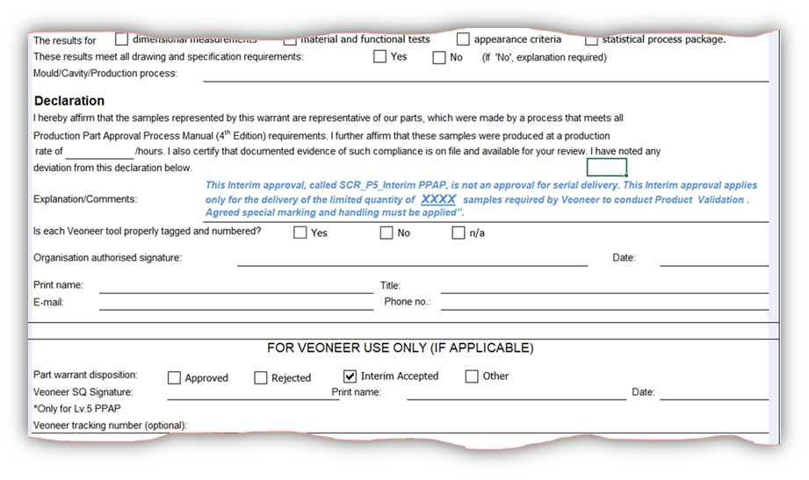
Supplier Change Request Management
Phase 4 : PPAP Approval or SCR_P5_Interim Approval (Con’t)
“SCR_P5_Interim PPAP” :
This Interim Approval doesn’t require escalation to Veoneer management, nor for the supplier to provide an Interim Recovery Work Sheet, as this Interim Approval is not Supplier caused.
The Standard PSW must be used, and the supplier is requested to add the following specific comment :
29

Slide 30
Phase 5 : Release for Serial Production

Slide 31
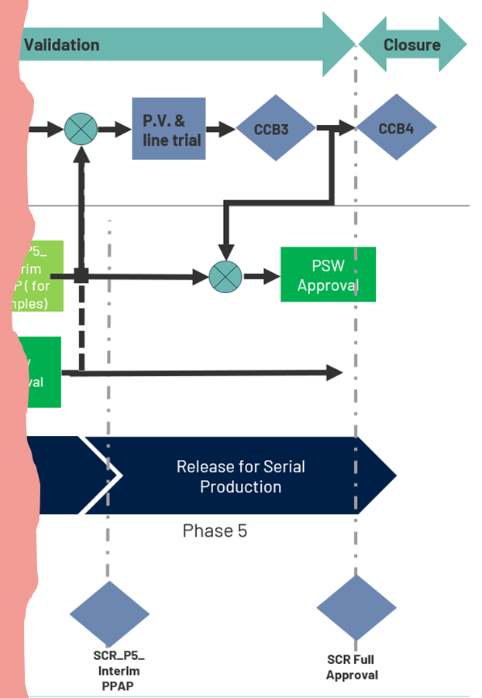
Supplier Change Request Management
Phase 5 : Release for Serial Production
After the PPAP or “SCR_P5_Interim PPAP” has been approved, the CCB change team can start running the P.V. (Product Validation) with samples having the change implemented.
Phase 5 corresponds to the process for SCR Final Approval and is associated with the “SCR Full Approval” Milestone.
In case Veoneer CCB3 is rejected the change will be rejected and Veoneer will not be liable for any cost.
If CCB3 is Approved :
For SCR with Veoneer Part Number Change, the “SCR Full Approval” Milestone will be approved immediately without waiting for the P.V. result.
For SCR without Veoneer Part Number change :
The Supplier and the Veoneer Project SQ can proceed for final PSW approval and “SCR Full Approval” will be granted.
In case the “SCR_P5_Interim PPAP” is over a year old, all SQP deliverables need to be reviewed for up-to-date documentation.
With “SCR Full Approval”, the supplier can start shipment as soon as orders are received.

Slide 32
Revision History :
Version # | Date | Author | Approver | Modification | Purpose
1.0 | Jan. 21, 2022 | Stephane Dumont | Dennis Nielsen | New Release | New Release

Slide 33

“Be the change you wish to see in the world “
Mohandas Gandhi

