Slide 1
Red Bin Audit and Reject Reduction Guideline
February 2020

Slide 2
Red Bin Audit and reject reduction training
1 - Why?
Initiatives
Supplier
Reduce waste
Reduce risk for possible customer claims / recall / Cat A issue in VEONEER
Process Improvements
Challenge Supplier to reduce risks and costs
Request supplier to include process of Red Bin Audit and reject reduction within the management system
Suppliers shall perform Red Bin Audit and reject reductions on a frequent basis (Audit plan of supplier)
Ensure focus of VEONEER visitors on Suppliers reject management
Cost of component + waste => price to VEONEER
Reducing reject = reducing price (possible)
Always take some time to look where value is added - “Go and See”
Quality doesn´t cost money, non-quality costs money!
Shift of focus on “Quality produced” instead of “Quality delivered”
Reduce risk of Veoneer receiving bad parts

Slide 3

Red Bin Audit and reject reduction training
1.1 – Why is professional reject analysis important?
“Every part in the Red Bin avoids a quality problem / Cat. A issue in VEONEER” and can be considered as Feedback to Manufacturing process
YES, but….only if you
Analyze it on time
Analyze it professionally
Communicate it on time to the right people
Take appropriate actions
Follow up the corrective actions
YES, excellent, nevertheless
Reject rate can be considered as a risk indicator: The higher the amount of NOK parts in the RED BIN the higher the risk to deliver NOK parts to VEONEER.
If not otherwise specified VEONEER does not accept any rework activities on defective parts.

Slide 4
Red Bin Audit and reject reduction training
2 – Who can support?
All VEONEER visitors to a Supplier can contribute.
Your eyes will see it from another angle. This is essential and will support quality improvements
By asking questions and make remarks you will encourage and push suppliers that often are “home blind” to their own risks and unnecessary costs
Supplier by implementing reject reduction program and RED BIN Audit as a part of the internal audit standard.

Slide 5
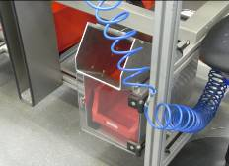
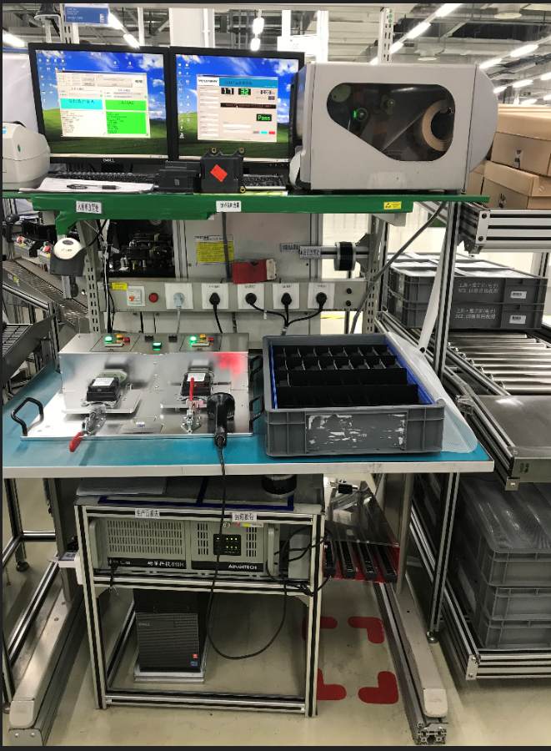
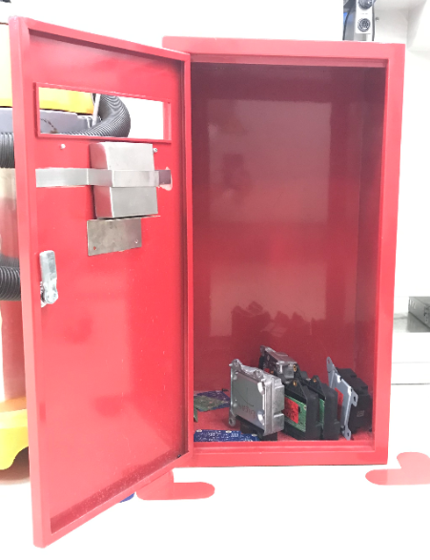
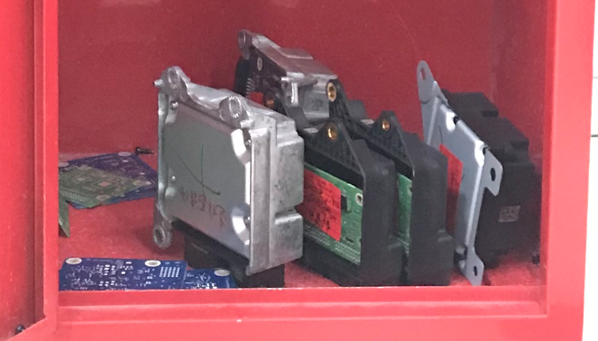

Red Bin Audit and reject reduction training
3 – How to perform?
Always plan a visit to the “Gemba” when going to suppliers
Check that there are Red Bins at production stations and used, preferably with locked covers and only a hole for parts thus reducing the risk for operators to make a mistake and use NOK parts
Are the operator, maintenance people, machine fitters trained in red bin usage? (e.g. training matrix)
Are there old materials (other part nos.) remaining in the boxes that indicate that regular analyses are not done?
NOK Parts
on shelf = risk
NOK Personal
belongings

Slide 6
Red Bin Audit and reject reduction training
3 – How to perform?
Is any re-work agreed with VEONEER?
Is there a follow-up chart on production floor showing worst reject causes in the area and if so, up to date?
Is a pareto analysis done for reject and if so are there actions related to that? Monitor and track root cause of problem and cost of poor quality.
Is the reject analysis part of the regular management review?
Is there a clear target setting for reject rate with steps to achieve zero internal ppm?
Is the Red Bin Audit part of the regular internal Audit plan?
Ask for containment actions to be sent to you and inform CSQ of agreed actions

Slide 7
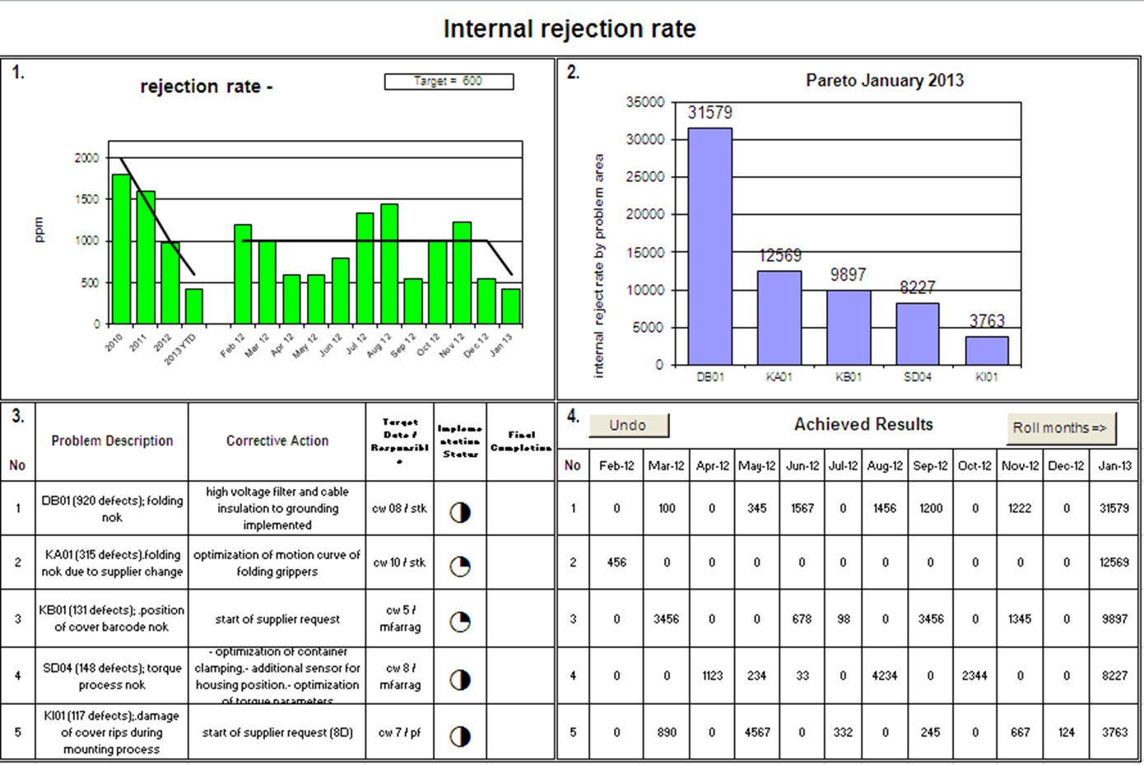
Red Bin Audit and reject reduction training
4 – Example how to monitor reject analysis

Slide 8
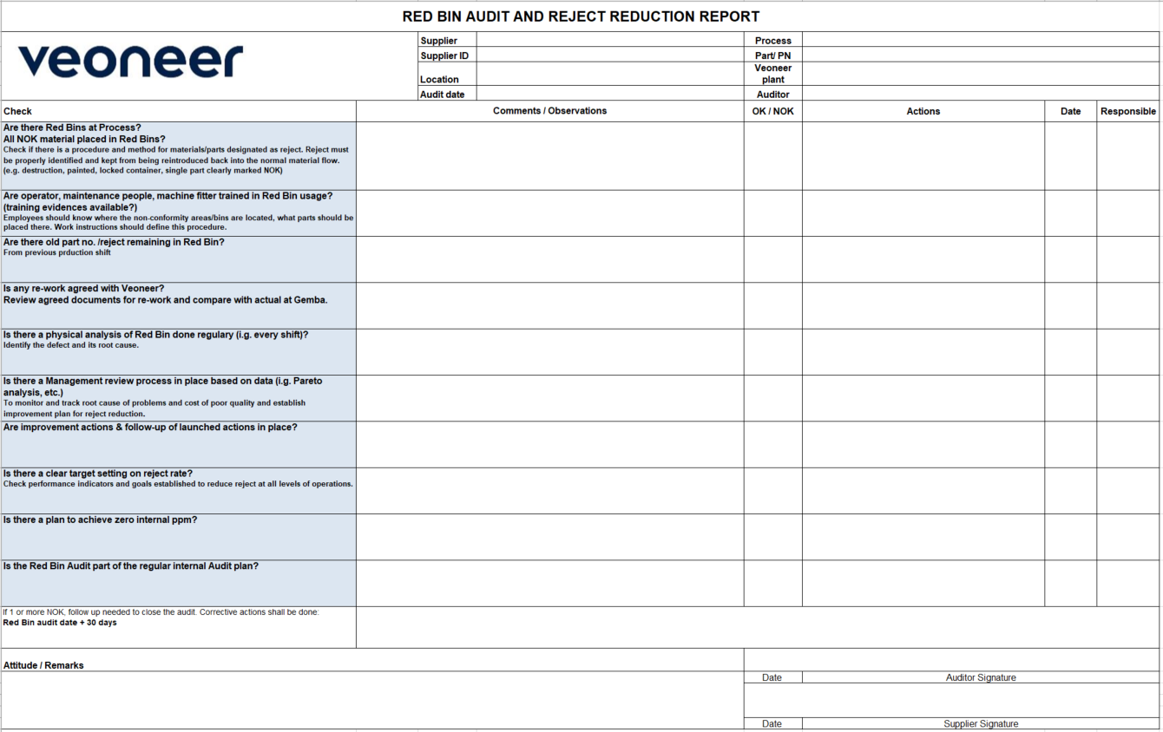
Red Bin Audit and reject reduction training
5 – Documentation / Actions

Slide 9
Red Bin Audit and reject reduction training
6 – Rating & Follow up
Corrective actions have to be taken for every NOK finding
Follow up has to be done in case of 1 or more NOK findings:
Red Bin Audit and reject reduction report date + 30 days
Review of evidence is mandatory to close the Red Bin Audit.
Follow up of Red Bin Audit and reject reductions have to be done on a regular basis with suppliers.
Trend review has to be installed at the supplier (per production line, per part no, etc.) with clear targets to achieve zero internal ppm.
Evidence could be reviewed via conference call / Go & See, and documented via e-mail.
Every Red Bin Audit and reject reduction report has to be send to Commodity Mgr./CSQ
VEONEER record storage in Supplier Board / Supplier Information / Quality / Audits

Slide 10
Red Bin Audit and reject reduction training
7 – Process flow
Responsible
Follow up & Review
actions of Red Bin Audit and
reject reduction
(all actions closed:
audit date + 90 days)
Start escalation via:
CSQ / Cdty Mgr/
leadbuyer
Auditorl
Responsible
Start
NO
Escalation
needed?
All
Visit at Supplier
(no visit @ supplier w/o
Red Bin Audit and reject reduction!)
Auditor
YES
Auditor
Perform Red Bin Audit and
reject reduction
(select process)
Use Red Bin Audit and
reject reduction
Report
Actions done
And Red Bin
Audit and reject
reduction
closed?
NO
Agree next steps with
the supplier incl time frame
to close the actions
Auditor
Agree with supplier about
the result of Red Bin Audit
and reject reduction and all
findings and needed actions
Sign Red Bin Audit and
reject reduction
Report
Auditor
YES
Update the Red Bin Audit and reject
reduction report with your
remarks and close the audit
Auditor
Follow up
needed?
Auditor
NO
Updated Red Bin Audit and reject
reduction to be stored in Supplier
Board and inform CSQ/CDTY Mgr
Supplier board db
Auditor
YES
Agree with supplier about
actions (date, etc) record
in Red Bin Audit and
reject reduction report
Auditor +
Supplier
End
Auditor
Red Bin Audit and reject
reduction to be stored in Supplier
Board and inform CSQ/CDTY Mgr
Supplier board db

Slide 11
Modification table
Revision | Date | Content of modification | Who did update | Remarks
02 | 2010-10 | first VEONEER release | J. TECHER

Slide 12
Thank You!

