Slide 1

Veoneer Supplier Development Program
Guideline & Agenda for Follow-Up Reviews
Frequency and timing of reviews:
• Monthly to 2-monthly review frequency
• Starting approx. 1 month after supplier diagnosis audits/surveys
• Location: preferably at supplier
• Duration: at Veoneer ½ day (try to combine 2 FU meetings) / at supplier 1 day
Participants: (bold = mandatory)
Veoneer:
• Commodity management delegate (usually commodity or lead buyer)
• Supplier development expert
• Project coordinator,other affected buyers
• Local purchasing / commodity management, supplier development manager
• SQE and SQA responsible
• Involved process or design engineers Supplier:
• for start-up-phase (minimum first 2 reviews) and every 2nd review: managing director
• quality manager
• production manager
• project manager, other involved process or design engineers, e.g. VES champions
Organisation of meetings:
• Commodity management delegate (usually commodity or lead buyer)
Preparation Veoneer (Responsible: Commodity management delegate) :
• Initial Supplier Performance Status regarding
1. Quality (DMR/ppm) and Delivery Performance (VS051 database)
2. PPAP status (On time / Right First Time)
3. VES status (as reported in Roadmap by supplier)
to be gathered and provided to supplier before the 1st review.
• Updated and agreed performance data prior to each review, including ppm- and PPAP highlights analysis
• Follow-Up-Meeting Agenda including Veoneer and supplier topics.
Preparation supplier (Responsible: Supplier) :
• Supplier response presentation (referring to current performance data provided by Veoneer) including
1. corrective action status for all open issues from initial audits,
2. quality, logistics and PPAP issues since program initiation / last review
3. supplier project management & collaboration system status ( Track 1)
4. supplier quality system status (VSM, VS002, IATF16949: Track 2)
5. supplier manufacturing system status (VES: Track 3)
• Report shall describe
1. main identified problem areas / products (e.g. regarding Zero-defect-philosophy,
training system, project management, APQP process, human ressources, orga etc.)
2. related root cause analysis,
3. interim and long-term action (detailed and overall management concept to reach the goal of 20ppm within a reasonable period of time) including evidence examples (e.g. forms, process descriptions, master plans, flow charts, lists etc.)
4. current performance data.

Slide 2
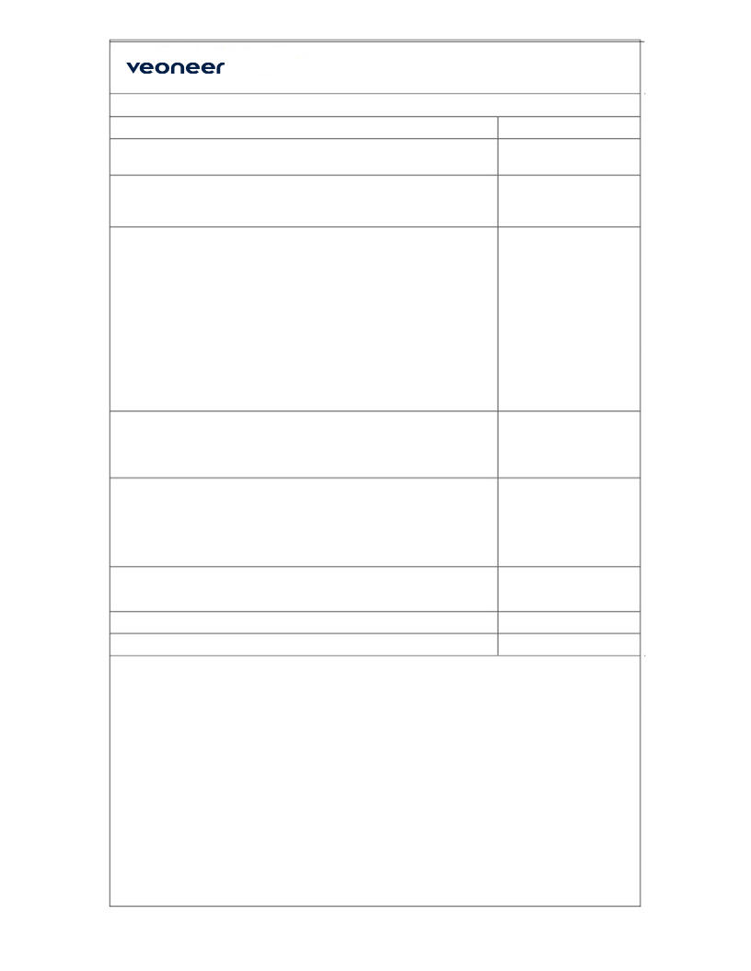
Veoneer Supplier Development Program
Guideline & Agenda for Follow-Up Reviews
Agenda of Reviews:
Topic
Responsible
1. Welcome and introduction
Commodity buyer +
Supplier
2. Supplier status summary from Veoneer perspective
Veoneer
Quality (DMR/ppm) / Delivery Performance (VS051 database) / PPAP status / VES Status
3. Presentation of supplier response report
Supplier
including
• corrective action status for all open issues from initial audits
• quality, logistics and PPAP issues since program initiation / last FU meeting
• supplier project management & collaboration system status (VPDS, VSPDS: Track 1)
• supplier quality system status (VSM, VS002, IATF16949: Track 2)
• supplier manufacturing system status (VES: Track 3)
4. Validation of reported evidence
Veoneer
• Review at Veoneer: Check documentation
• Review at supplier: “Go to Gemba”, check reality
5. Evaluation: Are supplier activities appropriate to
Supplier + Veoneer
• audit findings and performance history of the supplier ?
• the agreed quality targets ?
• reach 20 ppm processes and results ?
6. Open discussion
Veoneer + Supplier
• other supplier / Veoneer issues
7. Decision for next steps (write meeting minutes !)
Veoneer + Supplier
8. Agreement of date for next review.
Veoneer + Supplier
Remark:
After the concepts and action plans of the supplier will be once agreed and approved by
Veoneer, the following meetings will only update the action plans and quality results
(ppm+PPAP). If necessary, e.g. if the results does not meet the targets, the whole situation must be reviewed again and highest management involvement of supplier is demanded again.

