Slide 1
SQPS-061 User Guideline
Presentation of Continual Improvements Processes
Best viewed as Slide Show. Note that embedded examples can only be opened in Slide View

Slide 2
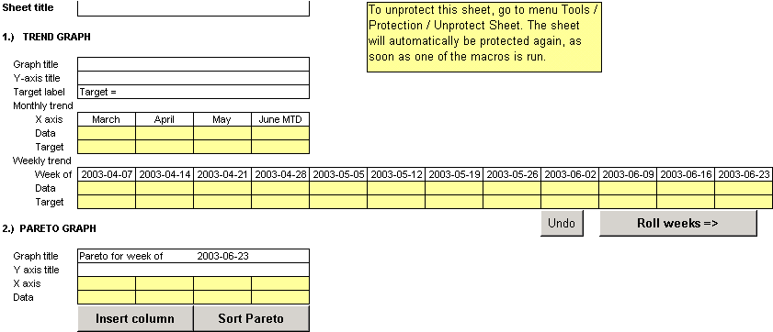
Data sheet/weeks
Name the sheet, it will show on the top of the graph sheet
The graph title should be the name of the measurable. It will show up at the top of panel 1
Add the target figure directly after “Target=“ followed by (YYYY-MM) to indicate when Target is planned to be met
Data of the 3 previous months plus MTD of current month is shown as the four first bars in the trend graph.
For the 12-week demonstration the oldest week is deleted whenever the new week is inserted. This is done automatically by a macro if you press Roll weeks
In the Pareto graph the actually presented week is shown
The Pareto can be sorted by pressing the button Sort Pareto
An additional column can be inserted by pressing the button Insert column
If a column shall be deleted, it must be made manually.

Slide 3
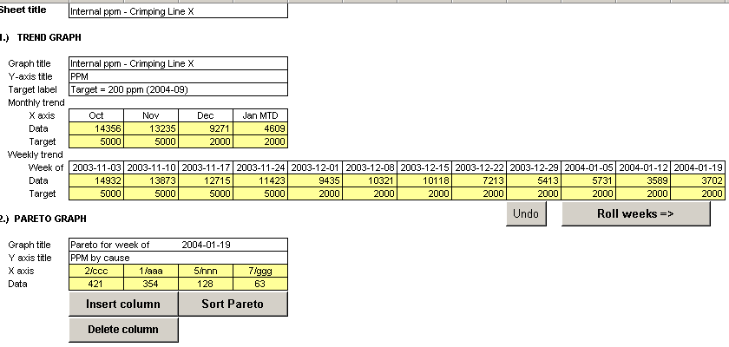
Data sheet/weeks
Name the sheet, it will show on the top of the graph sheet
The graph title should be the name of the measurable. It will show up at the top of panel 1
Add the target figure directly after “Target=“ followed by (YYYY-MM) to indicate when Target is planned to be met
Data of the 3 previous months plus MTD of current month is shown as the four first bars in the trend graph.
In the Pareto graph the actually presented week is shown
For the 12-week demonstration the oldest week is deleted whenever the new week is inserted. This is done automatically by a macro if you press Roll weeks
The Pareto can be sorted by pressing the button Sort Pareto
An additional column can be inserted by pressing the button Insert column
To delete a column press Delete column.

Slide 4
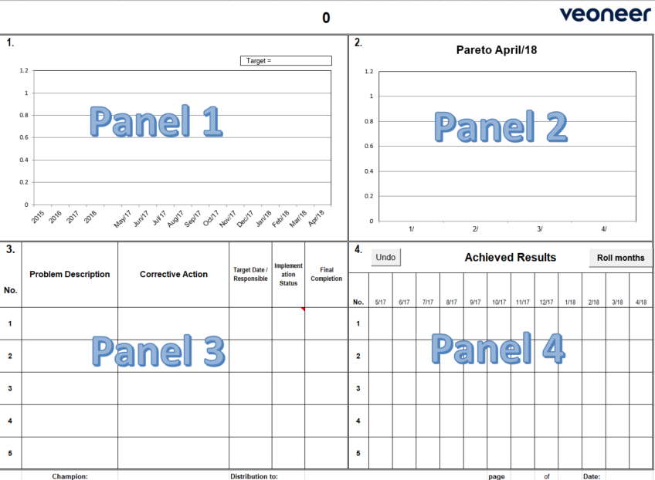
Graph sheet
PANEL 1
Trend chart with rolling 12 months / weeks plus past years/months data and
YTD/MTD of current
year/month. Target /
goal line that
could vary.
PANEL 2
Pareto chart that shows past month’s/week’s data only, usually 4 or 5 top causes of why target in Panel 1 is not met
PANEL 3
Problem description and corrective actions for the causes described in Panel 2. The serial number shall correspond to the one in the Pareto.
Each problem must have a target date and a responsible person defined. PDCA circles are used to show status of corrective action. When the corrective action is effective, the final completion date is set
PANEL 4
Chart with rolling 12 months /weeks, that tracks progress of improvement for each item from Panel 3. item can be deleted from Panels 3 & 4 when target achieved for 3 consecutive months/weeks

Slide 5
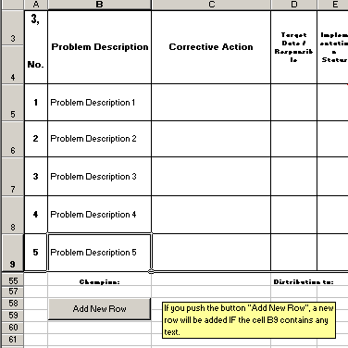
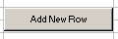
Graph sheet
Need more rows?
If you would like to add a new row in panel 3 and 4, click on the button “Add New Row”. Note that a row will only be inserted in case the last row contains any data in column B. Maximum 50 rows!
Hide rows?
If there is no data in column B and the button is pushed, all rows without data will be hidden.

Slide 6
Data sheet/weeks
Name the sheet, it will show on the top of the graph sheet
The graph title should be the name of the measurable. It will show up at the top of panel 1
Add the target figure directly after “Target=“ followed by (YYYY-MM) to indicate when Target is planned to be met
Data of the 3 previous months plus MTD of current month is shown as the four first bars in the trend graph.
In the Pareto graph the actually presented week is shown
For the 12-week demonstration the oldest week is deleted whenever the new week is inserted. This is done automatically by a macro if you press Roll weeks
The Pareto can be sorted by pressing the button Sort Pareto
An additional column can be inserted by pressing the button Insert column
To delete a column select Delete column.

Slide 7
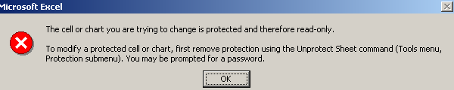
Editing
When you would like to modify cells in the data sheet, which are protected, you must unprotect the sheet. Go to menu Tools and choose Protection. Then Unprotect sheet. The sheet will be re-protected the next time one of the macros is run.

Slide 8
Revision History :
Version # | Date | Author | Approver | Modification | Purpose
1.0 | Apr. 1, 2018 | Brian Toyonaga |  | New Release | New Release
1.5 | Jan. 26, 2022 | Dennis Nielsen | Dennis Nielsen | Move to SQPS & Formatting | SQPS Release

